Slide 1


HEART ATTACK PREDICTION | A Machine Learning Approach
By: Aarti Ramani Date: 10/18/2023
DSC680-T302 Applied Data Science
Notes:
Hello, My name is Aarti Ramani. Today, we embark on a journey to explore a pervasive and complex health challenge - heart attacks.

Slide 2
INTRODUCTION
Heart attacks are a leading cause of sudden and fatal deaths globally, often requiring immediate medical intervention. It is a significant global health concern due to lifestyle-related risk factors, an aging population, healthcare costs, and treatment gaps.
Despite significant advancements in medical science, Heart disease still remains the leading cause of death in the United States, with the CDC reporting approximately 659,000 annual fatalities, accounting for one in every four deaths.
Notes:
This presentation delves into the business problem of heart attacks, and the multifaceted implications they have for public health, individuals, and healthcare systems.
Heart attacks are a leading cause of sudden and fatal deaths globally, often requiring immediate medical intervention. It is a significant global health concern due to lifestyle-related risk factors, an aging population, healthcare costs, and treatment gaps.
Despite significant advancements in medical science, Heart disease still remains the leading cause of death in the United States, with the CDC reporting approximately 659,000 annual fatalities, accounting for one in every four deaths.
Addressing this problem necessitates a holistic approach, covering aspects of prevention, early detection, access to quality healthcare, and improving cardiovascular health in individuals and populations.

Slide 3
PROCESS
Data Collection
Data Preparation (Cleansing & Transformation)
Exploratory Data Analysis
Model Building & Training
Model Evaluation
Notes:
Our journey through the heart attack prediction will be divided into several key steps. We'll delve into each step in upcoming slides.

Slide 4
DATA SOURCE (Collection)
The dataset used in this project is sourced from Kaggle(Fahad Mehfooz).
This dataset has around 12 features with around 900 rows.
Notes:
In terms of size, our dataset consists of approximately 900 rows and comprises around 12 features, each representing a unique aspect of a patient's health and medical history.

Slide 5
DATA PREPARATION
The following steps were performed to prepare the data for modeling.
Checked for null rows/columns in the data.
Performed checks for duplicates.
Renamed columns.
Notes:
In this slide, we'll discuss the steps taken to prepare and clean the data for modeling. Checks such as empty rows, duplicate rows, etc. are certain data transformation steps performed on this dataset.

Slide 6
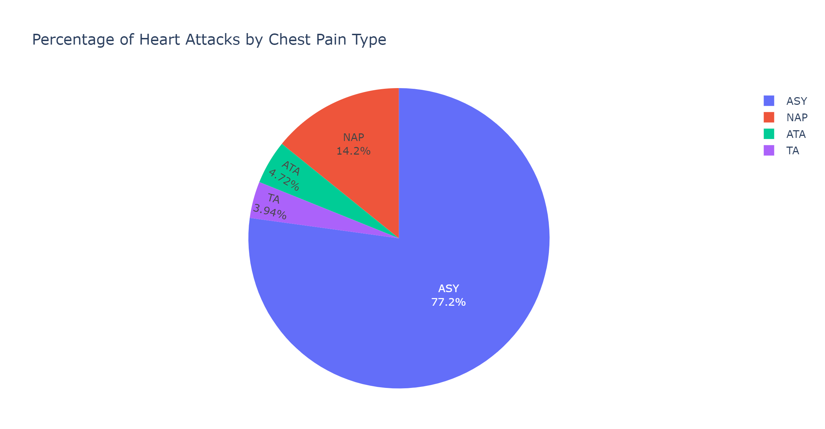
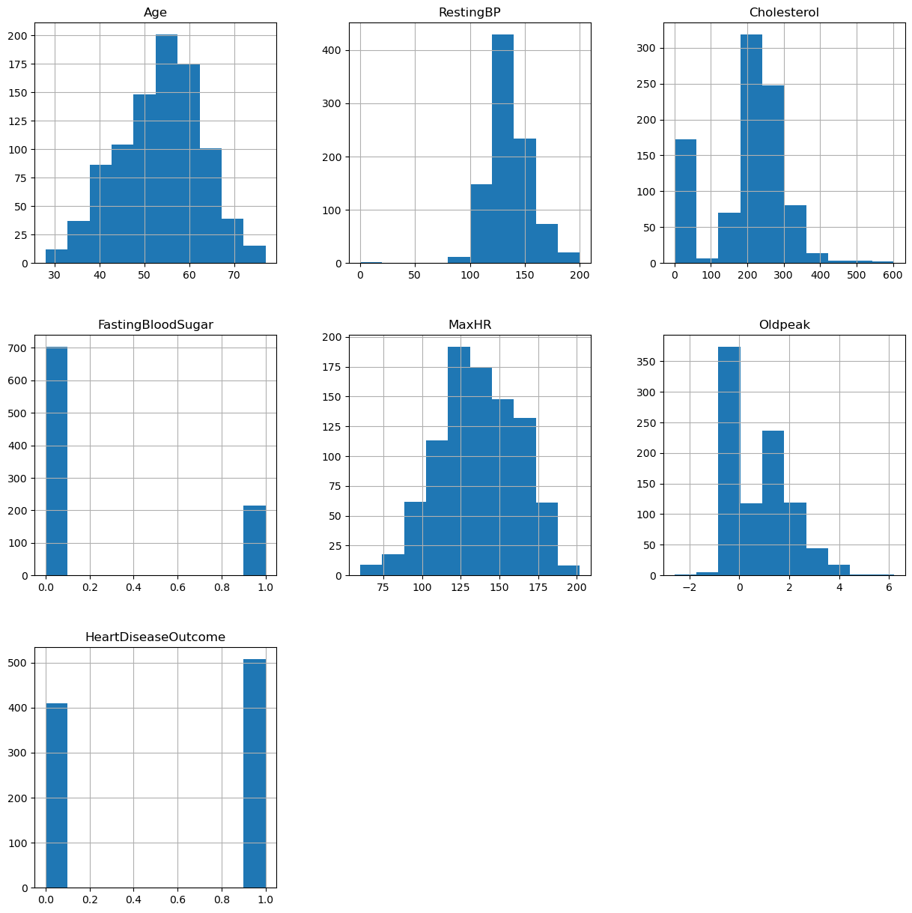
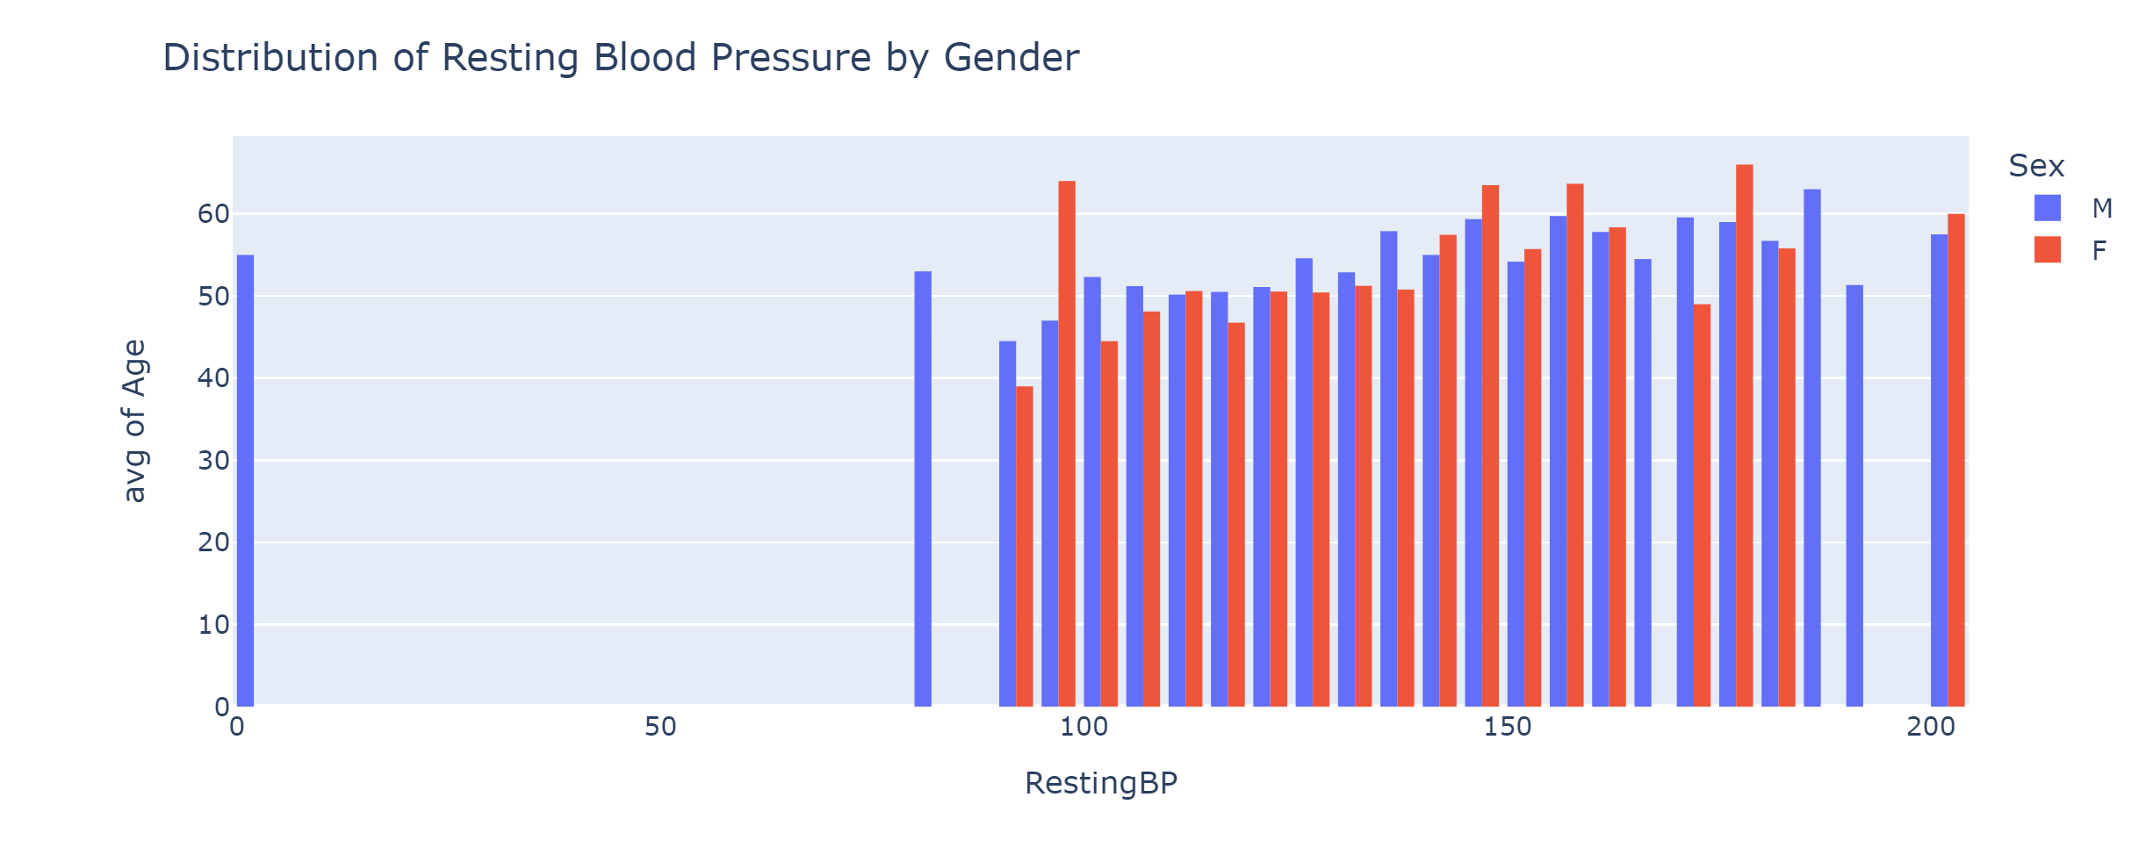
EXPLORATORY DATA ANALYSIS
Numeric Variables Distribution
Notes:
This slide showcases various visualizations created from our dataset.
A pie chart illustrating heart attack rates per chest pain type.
The 2nd chart displays the distribution of resting blood pressure and age per gender.
The third visualization showcases the distribution of numeric fields in the dataset.

Slide 7
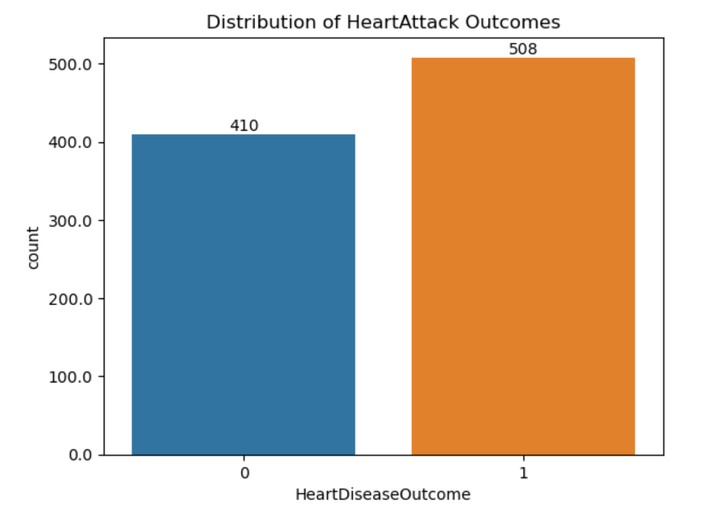
MODEL BUILDING & TRAINING
To construct an effective model, it was essential to check the dataset's balance. The current dataset seems to have a reasonable balance.
The StandardScaler preprocessing technique was applied to standardize or normalize numerical features.
Notes:
With the dataset now prepared and visualized, we move on to the next crucial step – building and training our models. To ensure our models are effective, we started by checking the dataset's balance, which, fortunately, appears reasonably balanced.
Additionally, we applied the StandardScaler preprocessing technique to standardize and normalize numerical features, an important step in ensuring our models are accurate and reliable.

Slide 8
The following models were developed, with their respective outcomes recorded.
Random Forest: A Random Forest model is a strong choice for predicting heart attacks due to its ability to handle complex relationships in the data, manage feature importance, and reduce overfitting. Its ensemble of decision trees provides high accuracy, and it's robust to noisy data. Furthermore, it can accommodate both numerical and categorical features, making it versatile for medical datasets.
Logistic Regression: Logistic Regression is a well-suited model for predicting heart attacks due to its interpretability, computational efficiency, and effectiveness in binary classification. Its scalability, regularization capabilities, and well-defined probability estimates make it a widely accepted and trusted choice in the medical field.
Support Vector Machine (SVM): A Support Vector Machine (SVM) is a strong choice for predicting heart attacks due to its ability to handle complex and non-linear relationships in the data. SVMs excel at separating data into different classes, making them effective for binary classification tasks like heart attack prediction. They work well with both numerical and categorical features and can be fine-tuned for optimal performance.
Naive Bayes: Naive Bayes is a viable choice for predicting heart attacks due to its simplicity, efficiency, and effectiveness in handling categorical and numerical features commonly found in medical data. It is particularly well-suited when feature independence assumptions hold reasonably true, making it a quick and efficient choice. Naive Bayes can provide valuable insights into feature importance and conditional probabilities, aiding in understanding risk factors.
Notes:
In this project, we built the Random Forest Classifier, Logistic Regression, Support Vector Machine, and Naïve Bayes models. This slide presents an overview of each model. We'll delve into the outcomes of each model in the upcoming slides.

Slide 9
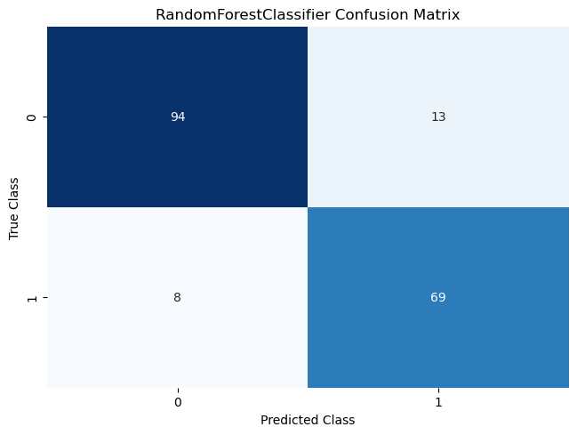
MODEL EVALUATION
Random Forest Classifier
Heart Attack Outcome | Precision | Recall | F1-Score
0 – No Heart Attack | 0.84 | 0.90 | 0.87
1 – Heart Attack | 0.92 | 0.88 | 0.90
Accuracy | ROC-AUC Score
88.6% | 0.887
Confusion Matrix
True Negatives (TN): 69 - These represent cases where the model correctly predicted 'No Heart Attack.'
False Positives (FP): 8 - Instances where the model incorrectly predicted 'Heart Attack' when the actual label was 'No Heart Attack.'
False Negatives (FN): 13 - These are cases where the model incorrectly predicted 'No Heart Attack' when the actual label was 'Heart Attack.'
True Positives (TP): 94 - Instances where the model correctly predicted 'Heart Attack.'
Notes:
The first model is the Random Forest Classifier. Here, we can see that this model showcases impressive results.
The Precision of this model is 0.84 for class 0 and an impressive 0.92 for class 1. This signifies that when our model predicts a heart attack, it is correct 92% of the time.
The model exhibits solid recall figures as well, capturing 88% of the class 1 (Heart Attack) cases.
The Random Forest Classifier achieves an accuracy of 0.886, indicating that it correctly predicts the outcome for nearly 89% of the cases.
The ROC-AUC score stands at 0.887 which suggests the model has a strong ability to distinguish between the two classes. In addition to these performance metrics, let's take a look at the confusion matrix for the Random Forest Classifier, which offers a detailed breakdown of the model's predictions, shedding light on its true positives, true negatives, false positives, and false negatives.

Slide 10
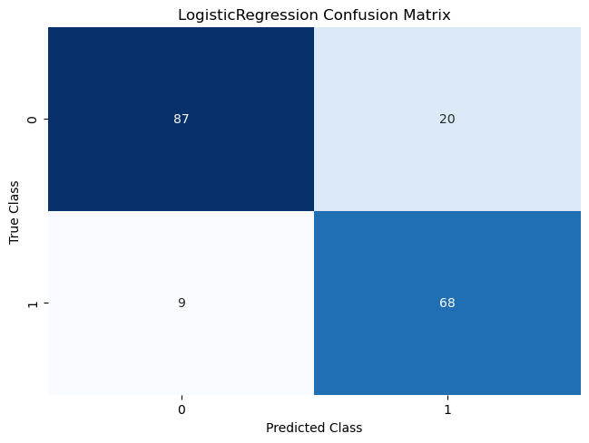
Logistic Regression
Heart Attack Outcome | Precision | Recall | F1-Score
0 – No Heart Attack | 0.77 | 0.88 | 0.82
1 – Heart Attack | 0.91 | 0.81 | 0.86
Accuracy | ROC-AUC Score
84.23% | 0.85
Confusion Matrix
True Negatives (TN): 68 - These represent cases where the model correctly predicted 'No Heart Attack.'
False Positives (FP): 9 - Instances where the model incorrectly predicted 'Heart Attack' when the actual label was 'No Heart Attack.'
False Negatives (FN): 20 - These are cases where the model incorrectly predicted 'No Heart Attack' when the actual label was 'Heart Attack.'
True Positives (TP): 87 - Instances where the model correctly predicted 'Heart Attack.'
Notes:
In this slide, we'll explore the outcomes of the Logistic Regression model. Its precision is 0.77 for class 0 and an impressive 0.91 for class 1, indicating a 91% accuracy in predicting heart attacks.
The model's recall figures are also commendable, capturing 81% of class 1 (Heart Attack) cases. Its overall accuracy stands at 84.2%, suggesting that it correctly predicts the outcome for around 84% of the cases.
The ROC-AUC score is 0.85. For a more in-depth understanding of its performance, let's dive into the confusion matrix, which offers valuable insights into its strengths and areas that may require fine-tuning.

Slide 11
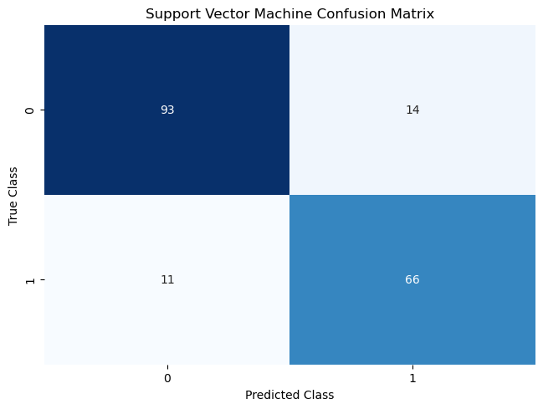
Support Vector Machine (SVM)
Heart Attack Outcome | Precision | Recall | F1-Score
0 – No Heart Attack | 0.82 | 0.86 | 0.84
1 – Heart Attack | 0.89 | 0.87 | 0.88
Accuracy | ROC-AUC Score
86.4% | 0.86
Confusion Matrix
True Negatives (TN): 66 - These represent cases where the model correctly predicted 'No Heart Attack.'
False Positives (FP): 11 - Instances where the model incorrectly predicted 'Heart Attack' when the actual label was 'No Heart Attack.'
False Negatives (FN): 14 - These are cases where the model incorrectly predicted 'No Heart Attack' when the actual label was 'Heart Attack.'
True Positives (TP): 93 - Instances where the model correctly predicted 'Heart Attack.'
Notes:
Let's now turn our attention to the Support Vector Machine (SVM) model and examine its performance in predicting heart attacks.
The Precision of this model is 0.82 for class 0 and 0.89 for class 1. This model predicts a heart attack 89% of the time.
The model exhibits good recall figures as well, capturing 87% of the class 1 (Heart Attack) cases.
The model achieves an accuracy of 0.864, indicating that it correctly predicts the outcome for around 86% of the cases.
The ROC-AUC score stands at 0.86 which suggests the model has a strong ability to distinguish between the two classes.
For an in-depth analysis of the model's performance, you can explore the confusion matrix breakdown.

Slide 12
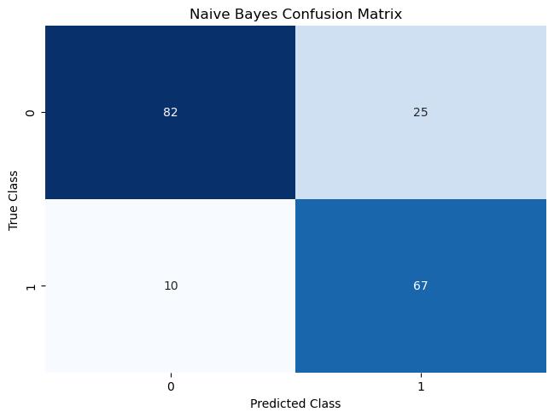
Naïve Bayes
Heart Attack Outcome | Precision | Recall | F1-Score
0 – No Heart Attack | 0.73 | 0.87 | 0.79
1 – Heart Attack | 0.89 | 0.77 | 0.82
Accuracy | ROC-AUC Score
80.98% | 0.82
Confusion Matrix
True Negatives (TN): 67 - These represent cases where the model correctly predicted 'No Heart Attack.'
False Positives (FP): 10 - Instances where the model incorrectly predicted 'Heart Attack' when the actual label was 'No Heart Attack.'
False Negatives (FN): 25 - These are cases where the model incorrectly predicted 'No Heart Attack' when the actual label was 'Heart Attack.'
True Positives (TP): 82 - Instances where the model correctly predicted 'Heart Attack.'
Notes:
Turning to the Naive Bayes model, we can see –
The Precision of this model is 0.73 for class 0 and 0.89 for class 1. This model predicts a heart attack 89% of the time.
The model exhibits good recall figures as well, capturing 77% of the class 1 (Heart Attack) cases.
The model achieves an accuracy of 0.809, indicating that it correctly predicts the outcome for around 81% of the cases.
The ROC-AUC score stands at 0.82 which suggests the model has a strong ability to distinguish between the two classes.
Similar to other models, you can explore the confusion matrix breakdown to gain a detailed understanding of the model's performance.

Slide 13
ETHICAL IMPLICATIONS
Following are a few of the many ethical considerations vital for this project.
Ensuring patient data privacy and obtaining informed consent.
Adhering to healthcare regulations, such as HIPAA (Health Insurance Portability and Accountability Act), and obtaining necessary approvals.
Respecting patients' autonomy and providing them with control over their data.
Engaging with healthcare professionals, patients, and institutions to incorporate their ethical perspectives.
Notes:
Adhering to healthcare regulations, such as HIPAA, ensures data security and privacy while collaborating with healthcare professionals and institutions helps us gather different perspectives and align our ethical principles with community needs.

Slide 14
CONCLUSION
Model | Random Forest Classifier | Logistic Regression | Support Vector Machine | Naïve Bayes
Accuracy | 88.6% | 84.23% | 86.4% | 80.9%
In summary, this project aimed to predict the likelihood of heart attacks using different machine learning models. We explored models such as, logistic regression, random forests, Naïve Bayes, and Support Vector Machine. We've uncovered vital insights into this pressing health concern, and our machine-learning models have shown promise in early detection and prevention.
Notes:
Considering the model metrics, we can confidently say that our predictive models are powerful tools for heart attack prediction. The Random Forest model stands out with an accuracy of 88.6% and an impressive ROC-AUC score of 0.887. Logistic Regression and Support Vector Machine (SVM) also perform well with accuracy scores of 84.23% and 86.4% respectively. Naive Bayes, although slightly less accurate, provides reasonable results with an accuracy of 80.9%. Each model has its strengths and trade-offs, but collectively, they offer valuable insights and tools for heart attack risk assessment and prevention.

Slide 15
REFERENCES
Fahad Mehfooz. HeartAttack prediction with 91.8 % Accuracy, Kaggle - https://www.kaggle.com/code/fahadmehfoooz/heartattack-prediction-with-91-8-accuracy/input?select=heart.csv

Slide 16
THANK YOU
Notes:
Our journey through heart attack prediction has showcased the potential of machine learning in healthcare. Thank you all for being part of this journey. If you have any questions or insights, please feel free to share them. Thank you.

